Slide 1
HEDA User Group Workshop Staff Time Sheets 16H30 – 17H15
20 November 2013

Slide 2
HEDA Staff Time Allocation Module – Current purpose and practice
Staff “time” allocation completion is compulsory for all instruction/research staff and is scheduled annually during October/November.
UJ does not use this module to calculate the FTE of a staff member.
The main purpose of this module to date was to
fraction out the staff FTE in terms of HEMIS element 044 (staff programme); and
To obtain the link for a staff member to element 045 (staff program CESM)

Slide 3
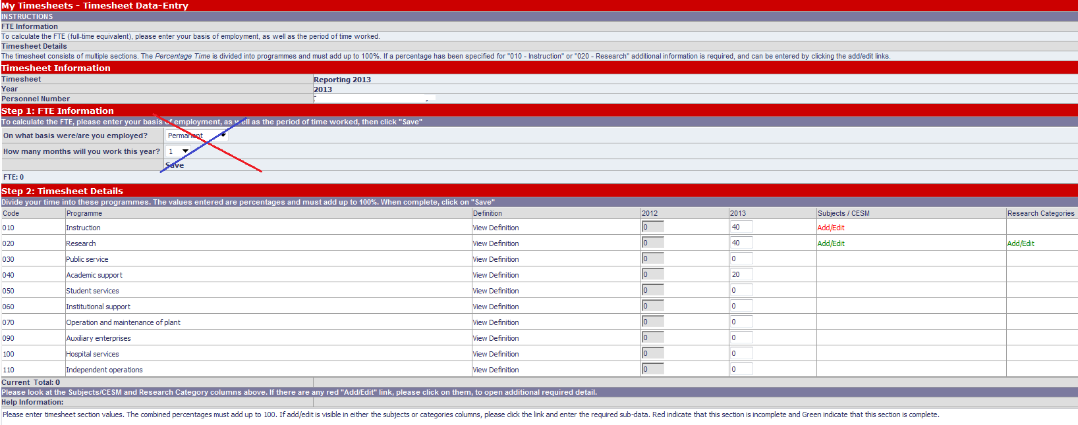

Slide 4
Instruction Section
Only list courses (modules) whish are recorded in the CREG file

Slide 5
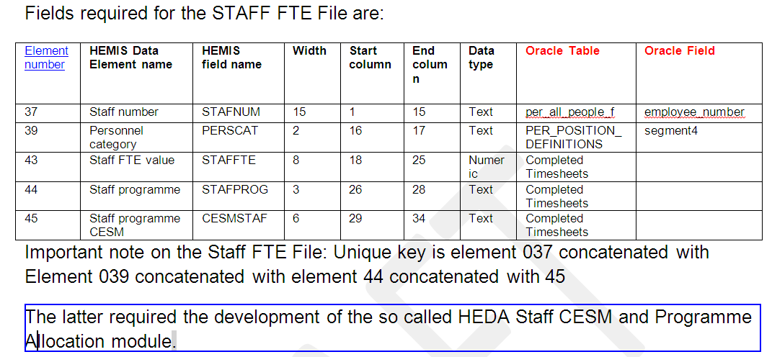

Slide 6
HEDA Staff CESM and Programme Allocation Module – needs requirements
Expand to include Non-subsidized or short courses
Expand the application to accommodate more dimensions on the Instruction Section
Identify the primary department of a staff member and the involvement in secondary departments in terms of Instruction
Accommodate some data integrity – CREG compared to staff programme 01 completion
Student to Staff ratios on various information levels can be calculated
Relate staff load to success rates
Investigate possible link with RIMS staff FTE requirements

Slide 7
HEDA Staff CESM and Programme Allocation Module:
Expand to include Non-subsidized or short courses
To accommodate the recording of these in a similar way to how the formal courses/modules are being recorded currently
This is in addition to the current practice and should not alter the rule for the percentage calculations as it is applied to date
This might require a additional step linked to staff programme 01

Slide 8
HEDA Staff CESM and Programme Allocation Module
Dimensions on Instruction
Instruction staff with a primary appointment and in most cases are also assigned secondary assignments
How this relates to instruction requires a capability of accommodating various dimensions from which this information can be viewed
Staff 1
Module 1 (Dept. 1)
Qual. 1
Qual. 2
Module 2 (Dept. 2
Qual.3
Staff appointment Information (Primary is Dept. 1)
Course (module) Information
Qualification Information
Faculty; Campus Dept.;Qual.Type
Faculty; Campus Dept.;Qual.Type

Slide 9
HEDA Staff CESM and Programme Allocation Module
Discussion

Slide 10
HEDA User Group Workshop Dashboards 09H15 – 09H45
21 November 2013

Slide 11
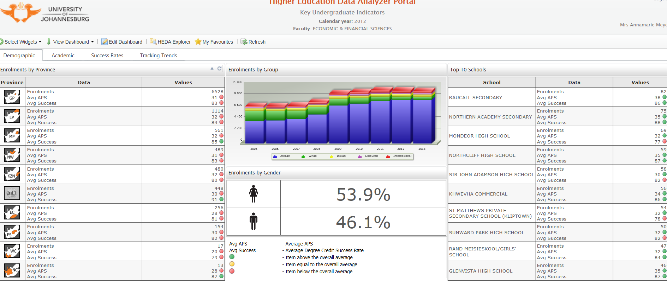
Order by

Slide 12
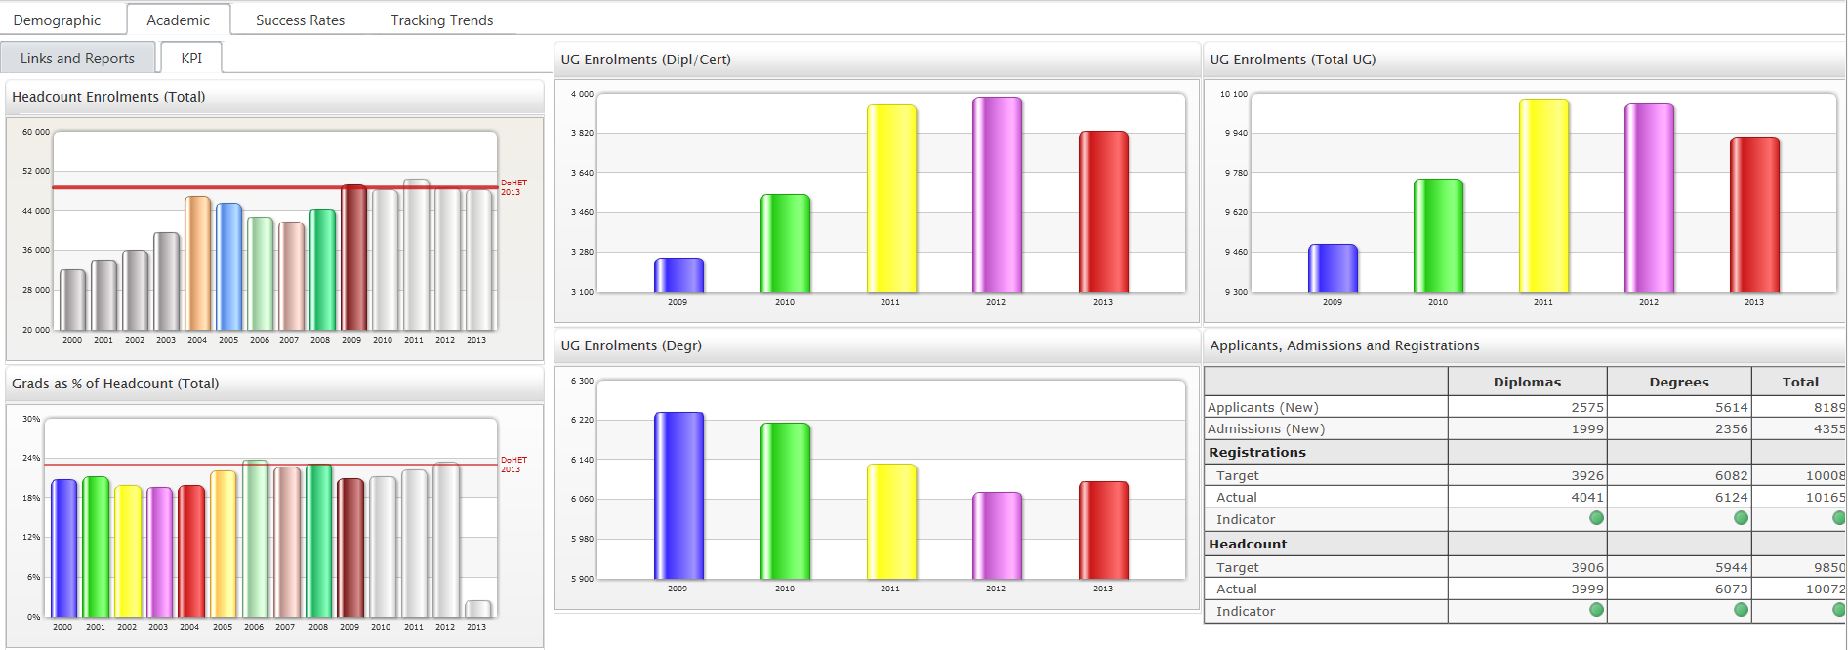

Slide 13
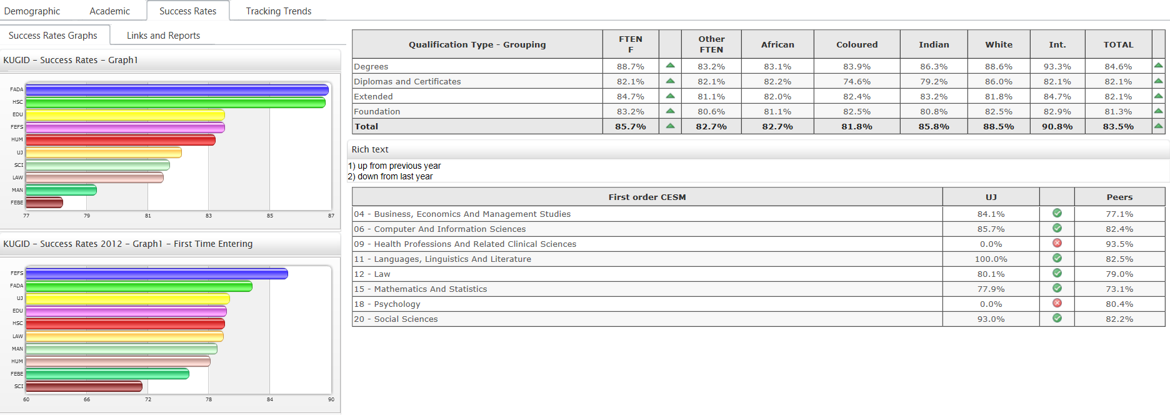

Slide 14
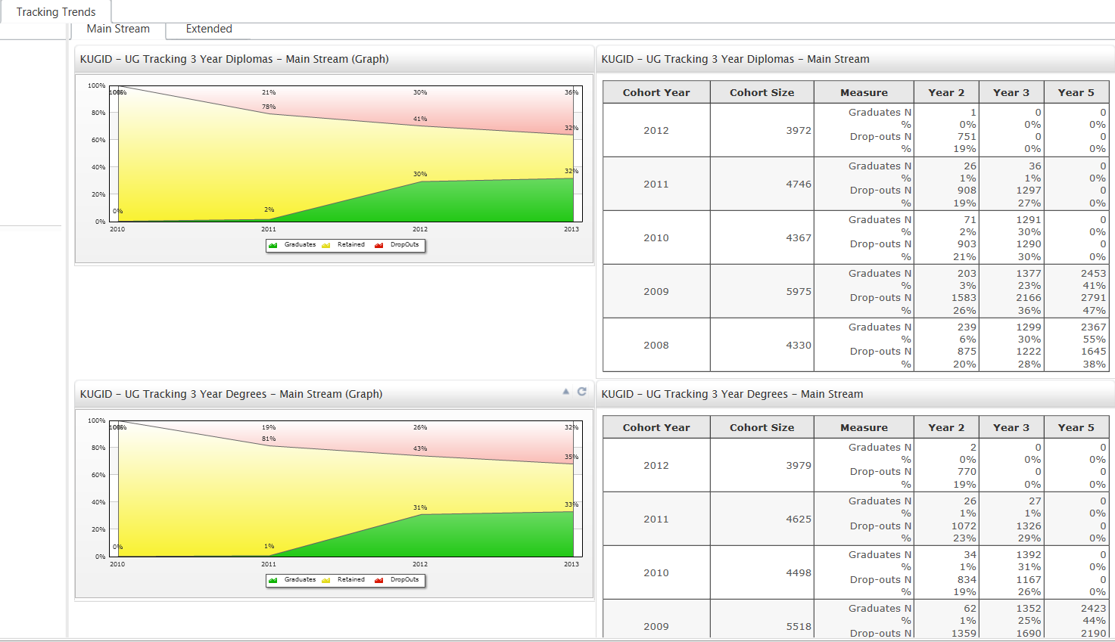

Slide 15
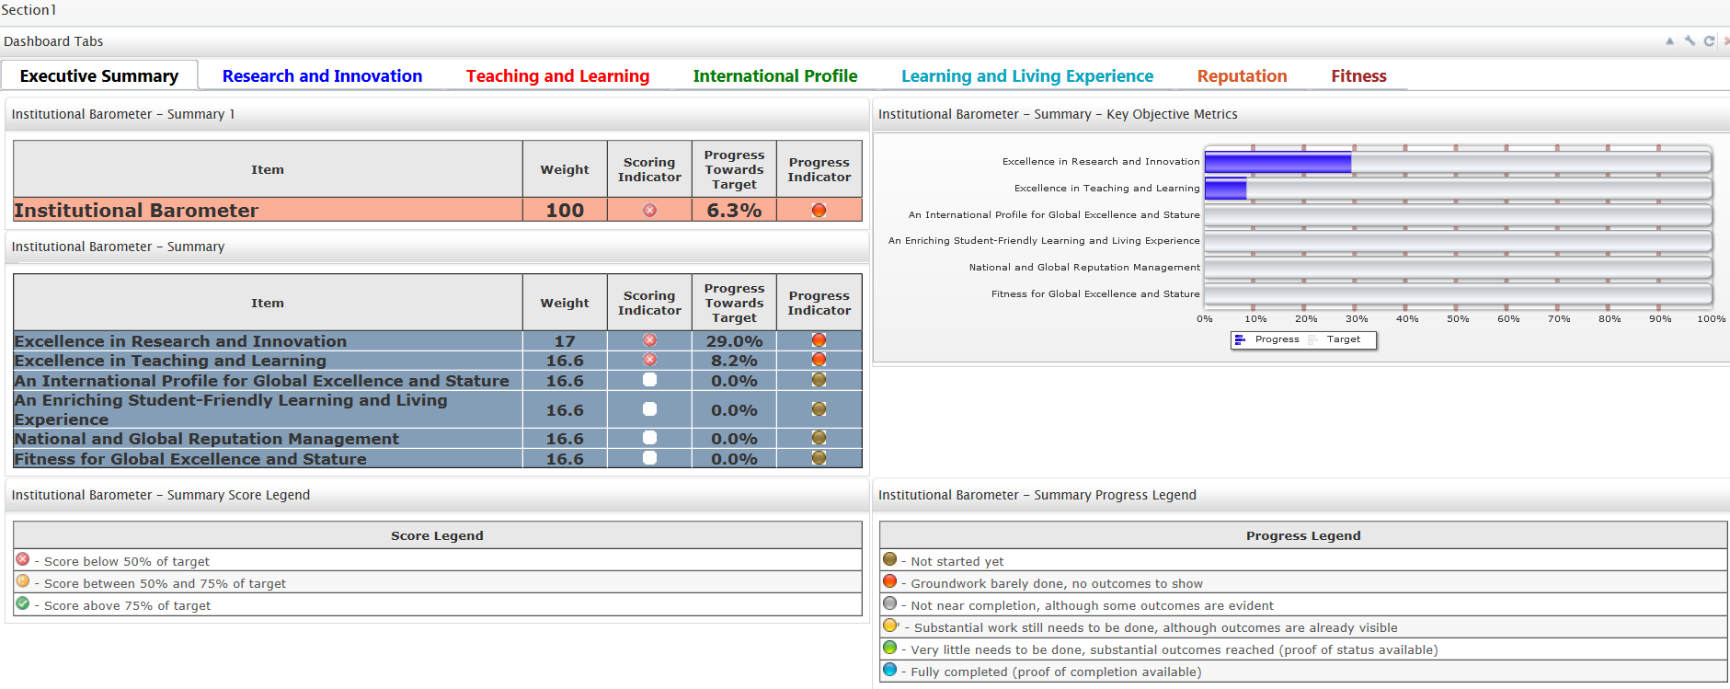

Slide 16
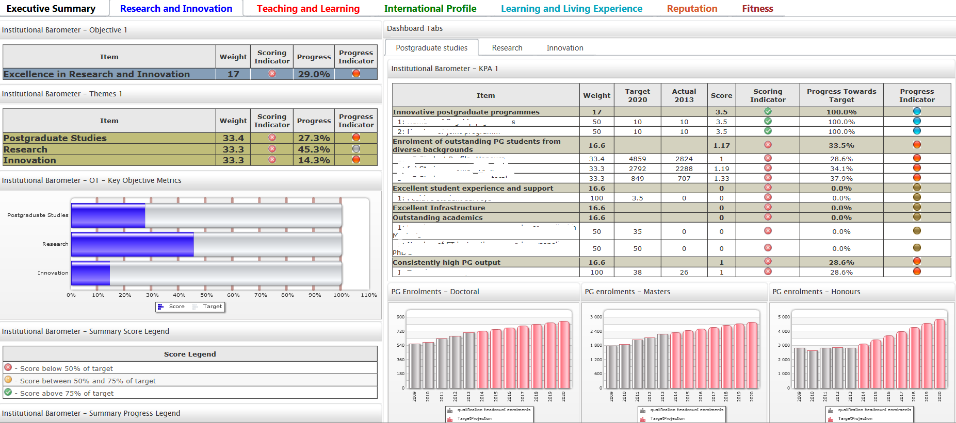

Slide 17
HEDA User Group Workshop Staff, Subject & Curriculum Audit 08H15 – 09H15
22 November 2013

Slide 18
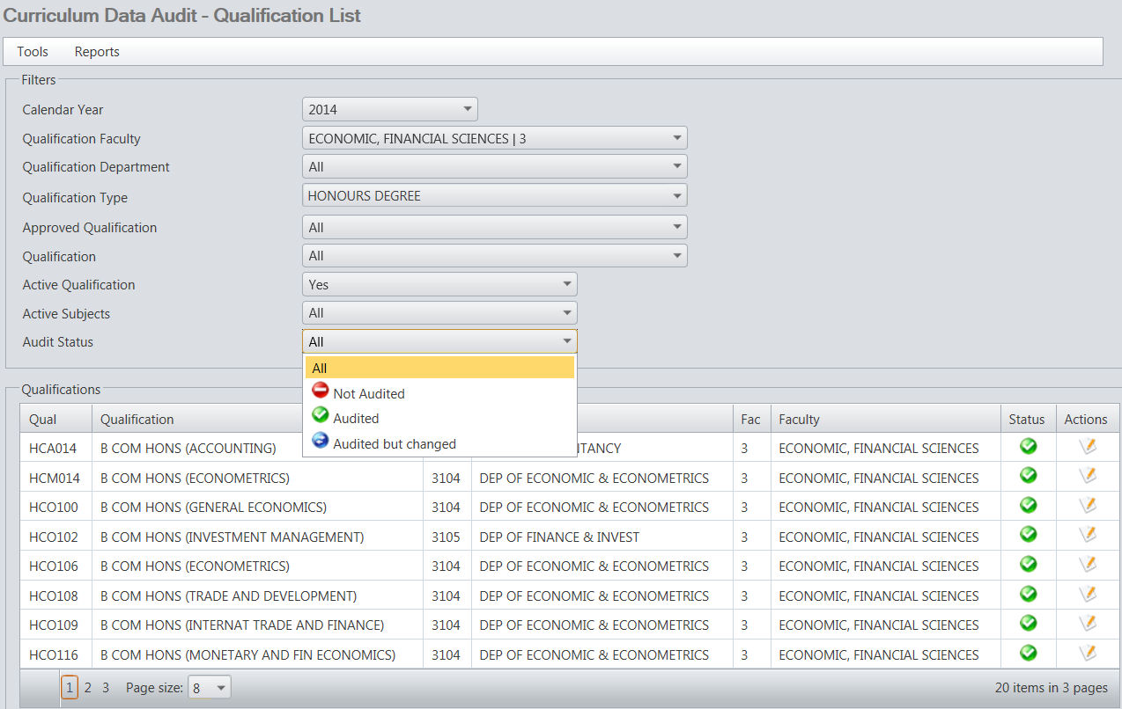

Slide 19
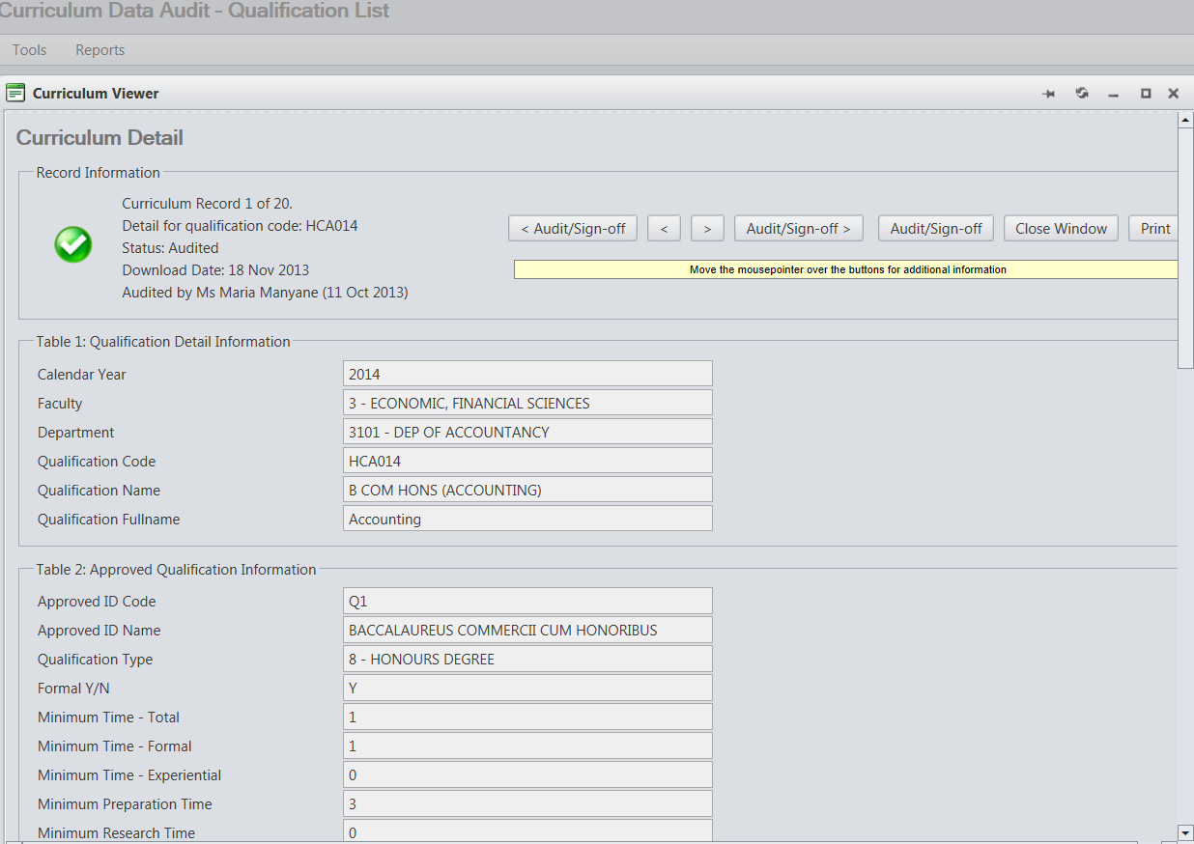

Slide 20
